Slide 1
Electronic Devices
Final Term Lecture - 06
Reference book:
Electronic Devices and Circuit Theory (Chapter-7)
Robert L. Boylestad and L. Nashelsky , (11th Edition)

Slide 2
OBJECTIVES
Be able to perform a dc analysis of JFET, MOSFET, and MESFET networks.
Become proficient in the use of load-line analysis to examine FET networks.
Develop confidence in the dc analysis of networks with both FETs and BJTs.
Understand how to use the Universal JFET Bias Curve to analyze the various FET configurations.

Slide 3
GENERAL RELATIONSHIPS
For all FETs:
For JFETs and Depletion-Type MOSFETs:
For Enhancement-Type MOSFETs:
BJT: Linear Relationship between I_{B} and I_{C}
FET: Non-linear Relationship between V_{GS} and I_{D}.

Slide 4
COMMON FET BIASING CIRCUITS
JFET
Fixed – Bias
Self-Bias
Voltage-Divider Bias
Depletion-Type MOSFET
Self-Bias
Voltage-Divider Bias
Enhancement-Type MOSFET
Feedback Configuration
Voltage-Divider Bias

Slide 5
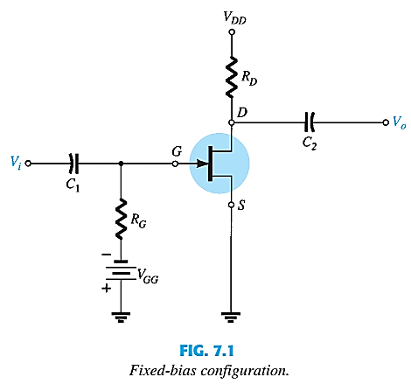
FIXED-BIAS JFET
The simplest biasing arrangements:
For the DC analysis,
Capacitors are open circuits
The zero-volt drop across R_{G} permits replacing R_{G} by a short-circuit.

Slide 6
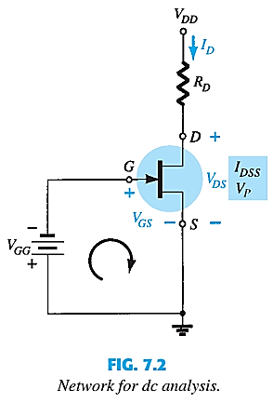
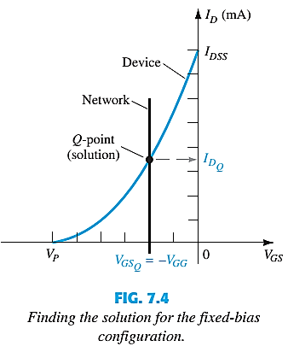
FIXED-BIAS JFET
Can be solved using either Mathematical Approach or Graphical Approach:
Mathematical Approach
Graphical Approach

Slide 7
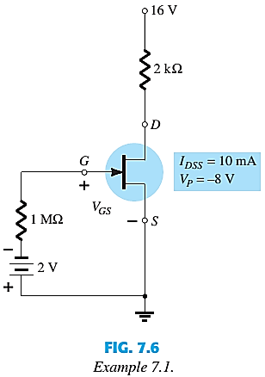

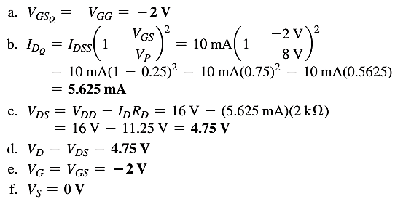
FIXED-BIAS JFET EXAMPLE
Determine V_{GSQ}, I_{DQ}, V_{DS}, V_{D}, V_{G}, V_{S}.

Slide 8
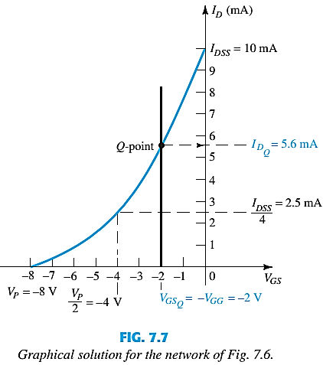
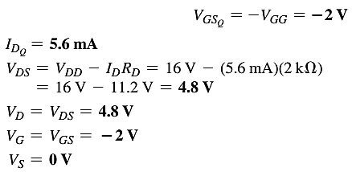
FIXED-BIAS JFET EXAMPLE
Graphical Approach
V_{GS} | I_{D}
0 | I_{DSS}
0.3V_{P} | I_{DSS}/2
0.5V_{P} | I_{DSS}/4
V_{P} | 0mA

Slide 9
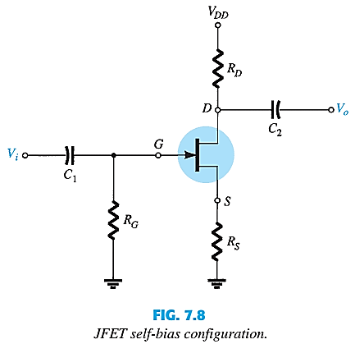
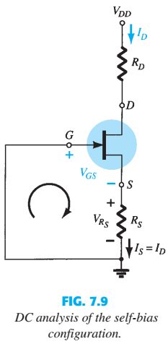
JFET: SELF-BIAS CONFIGURATION
The self-bias configuration eliminates the need for two dc supplies.

Slide 10

SELF-BIAS CONFIGURATION
Can be solved using either Mathematical Approach or Graphical Approach:

Slide 11
SELF-BIAS CONFIGURATION
Graphical Approach
Draw the device transfer characteristic using shorthand method.
Draw the network load line
Use to draw straight line.
First point,
Second point, any point from I_{D} = 0 to I_{D} = I_{DSS}. Choose
The Q-point obtained at the intersection of the straight line plot and the device characteristic curve.
The quiescent value for I_{D} and V_{GS} can then be determined and used to find the other quantities of interest.

Slide 12

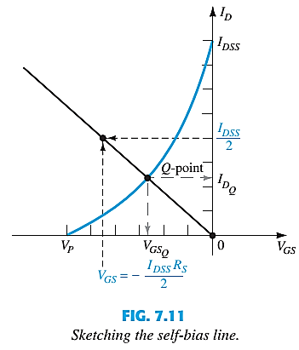
SELF-BIAS CONFIGURATION

Slide 13
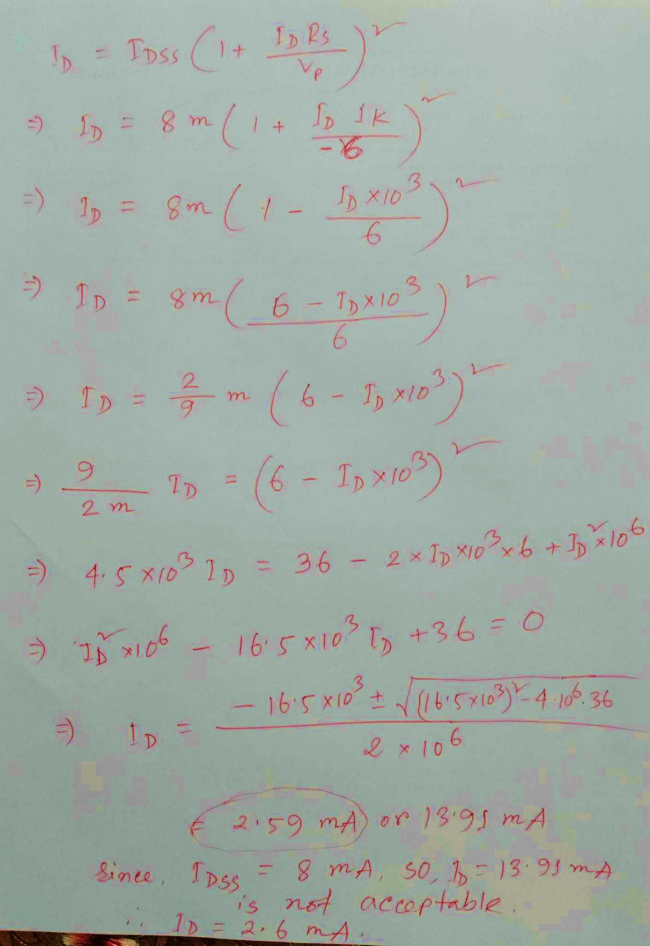
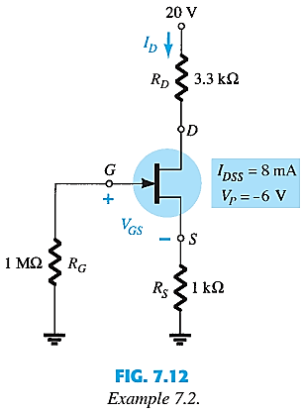
SELF-BIAS EXAMPLE
Determine V_{GSQ}, I_{DQ},V_{DS},V_{S},V_{G} and V_{D}.
V_{GS} = -2.6 mA x 1 k
= -2.6 V

Slide 14
End of Lecture-6

